Slide 1

AN EXCLUSIVE MOBILE APP
for employees related to
showroom, sales, and complaints management.

Slide 2
FLOW OF MOBILE APP
SHOWROOM PERSPECTIVE

Slide 3
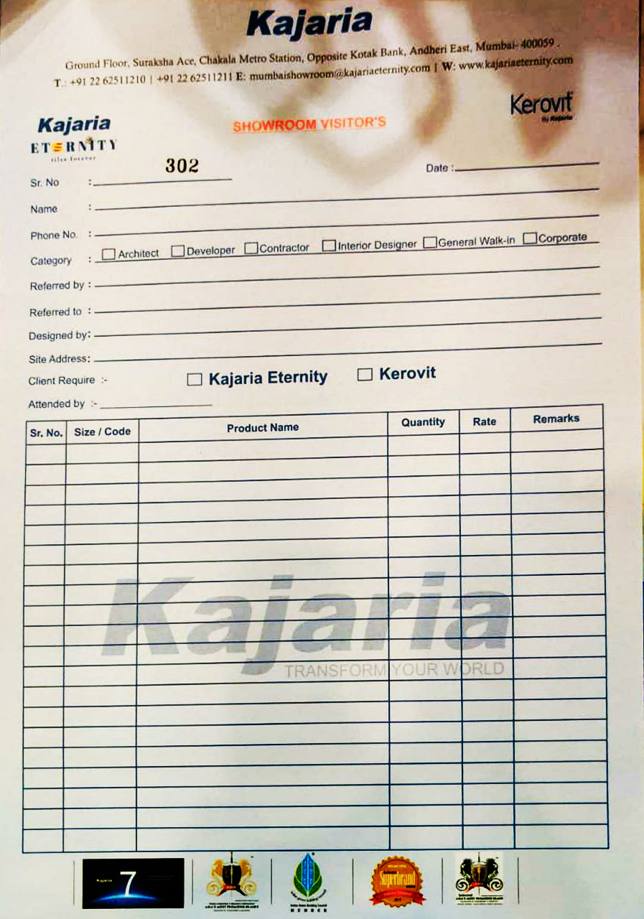
OBJECTIVE
Objective is to digital automation of a form (showing right side) for our showroom where they can take the requirements of products digitally.
REFERENCE
(RIGHT NOW, THEY ARE USING OFFLINE FORM)

Slide 4
THE PROJECT HIERARCHY.
Here's an example for Mumbai as a reference.
Showroom Executives: Ms. Fatima
Sales Team: Mr. Chirag, Ms. Nidhi, Mr. Rajesh, Ms. Mamta
Team Leader: Mr. Amit Jain

Slide 5
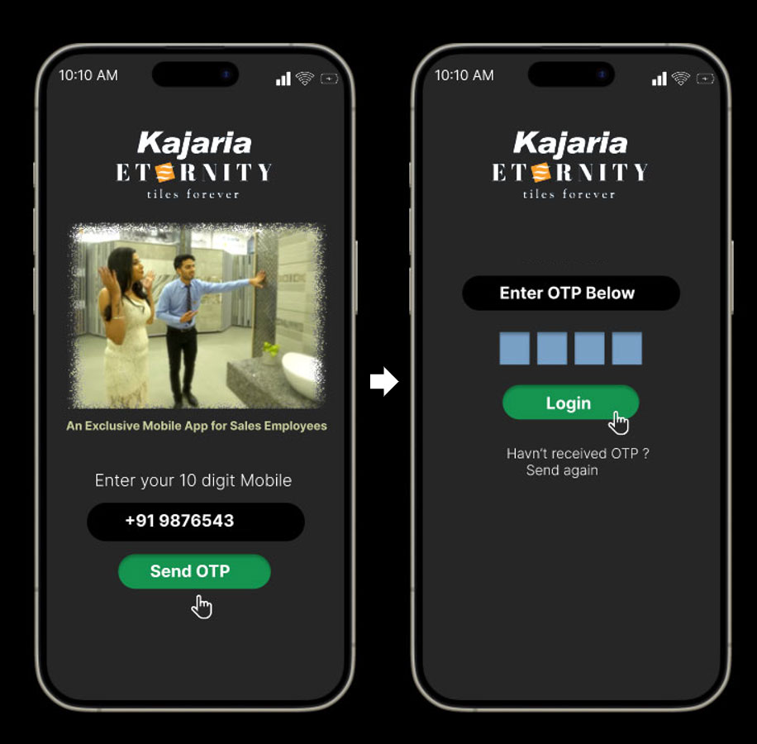
Let’s assume
Ms. Fatima is a showroom executive of our Mumbai Showroom.
She will log into the app with her registered mobile number and verify it with an OTP.
Hi Fatima

Slide 6
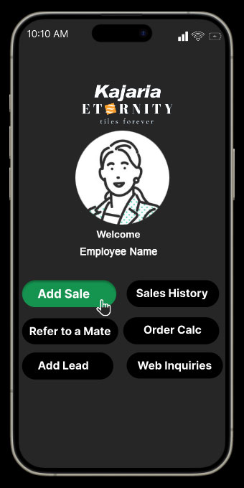
What we offer to Ms. Fatima.
Add Sale: This means adding a new customer visiting the showroom.
Sales History: To view all previous visits of the customers attended by her.
Refer to a Mate: If she is absent, she can refer an existing customer to a colleague.
Add Lead: If a new customer calls the showroom, she can add their name in the app and instantly send complete showroom details via the Eternity WhatsApp account including Location and 360° view.
Web Inquiries: She can view all inquiries from the website and social media of the customer according to their respective areas.
Fatima

Slide 7
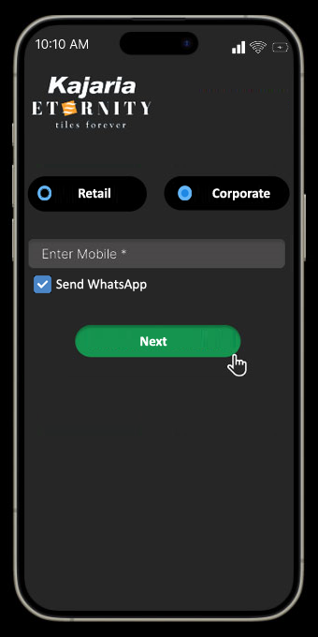
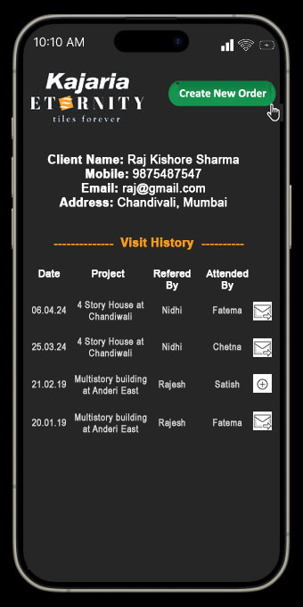
Once Ms. Fatima enters the customer's mobile number, she will have the following options:
View all visits of that customer, displayed in Screen 2.
Access complete details only for customers attended by her.
Request permission from the sales employee mentioned in the "Referred by" section by clicking an icon to view details of other customers who weren't attended by her.
If permission is not granted, she can create a new order and select the same project name for which the customer came.
Screen 1
Screen 2

Slide 8
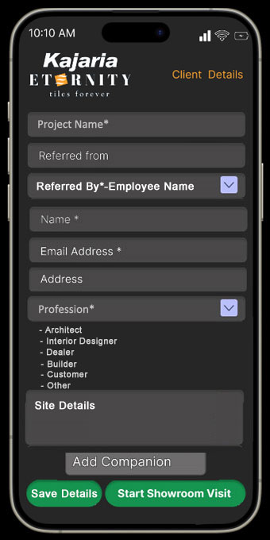
ADD SALE – Customer Record Management System
The customer's mobile number acts as their unique ID.
The app displays pre-filled customer details, project names, etc., if they have visited before.
Showroom Executive can note accompanying individuals and their professions.
Showroom Executive can select the name of a sales employee from the 'Referred by' section, who can then assign the lead to their dealer.
Showroom Executive save the details of the customer for its future visit as well.

Slide 9
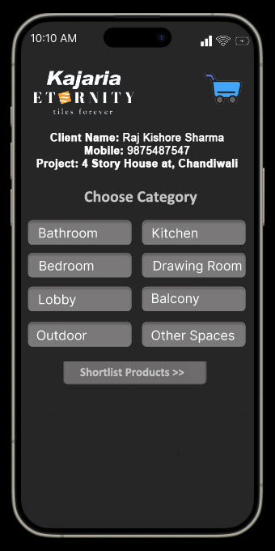
ADD SALE – Area for Which Tiles Are Required
We offer pre-defined category options to save Ms. Fatima time from typing manually.
If she clicks on the bathroom category, she can instantly input bathroom size, floor, or any other details she wants to add.
On the next screen,
it will demonstrate how Fatima can add SKUs.

Slide 10
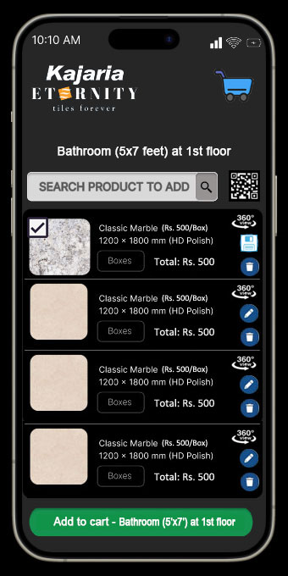
ADD SALE – Instantly Adding Product to Cart with 360° View
Search Product: Ms. Fatima can type 4 characters of the SKU, and it will automatically appear in the app for adding to the cart.
QR Scan: We provide the option to scan QR codes showing on the display. SKUs will be added automatically.
All details of the SKU, such as size, finish, 3D view, and technical specifications, will be added automatically.
Ms. Fatima can edit any information at any stage before sending it to the customer.
MRP of the SKU’s will add automatically.
The customer will receive the same details on WhatsApp after leaving the showroom.

Slide 11
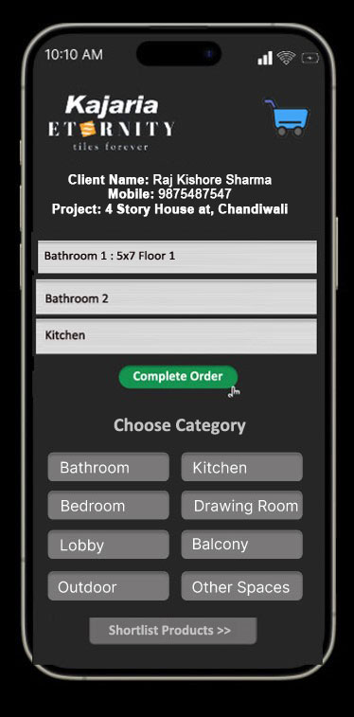
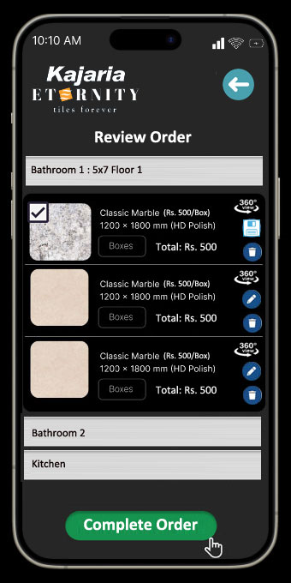
ADD SALE – Instantly Adding Product to Cart with 360° View

Slide 12
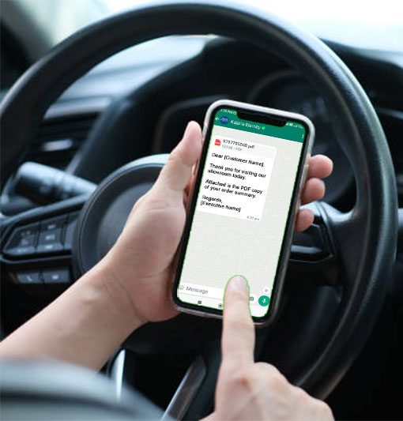
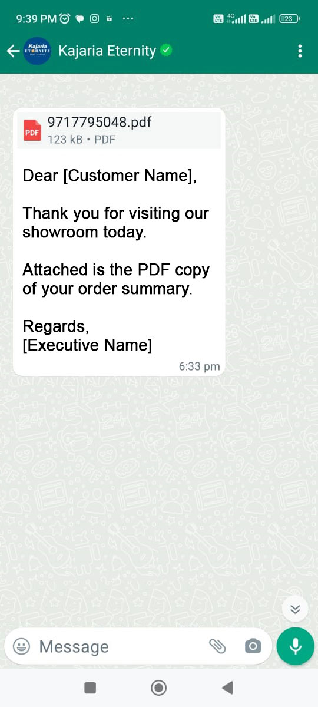
ADD SALE – Instant WhatsApp Notifications to Customers
The customer will receive a WhatsApp message as soon as the employee clicks on the submit button.

Slide 13
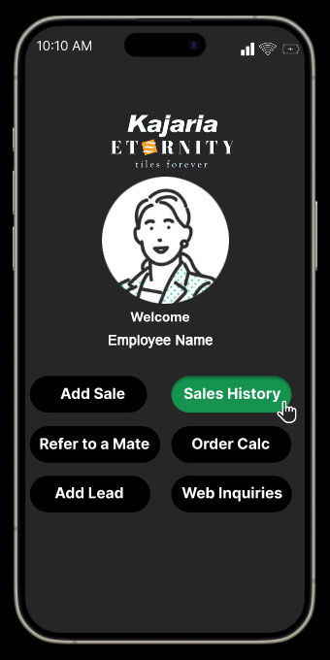
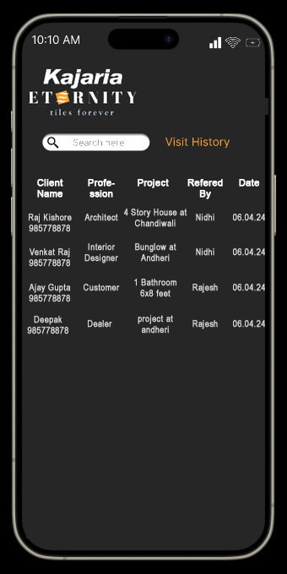
SALES HISTORY
Ms. Fatima can view reports of customers she has attended to previously—sorted by date and month.
She can instantly call any customer from the app, if required.
She can search customer by name, projects, referred by, and profession.
Note: This screen is highly personalized, and Ms. Fatima cannot see any customer details attended to by other showroom executives.
Ms. Fatima

Slide 14
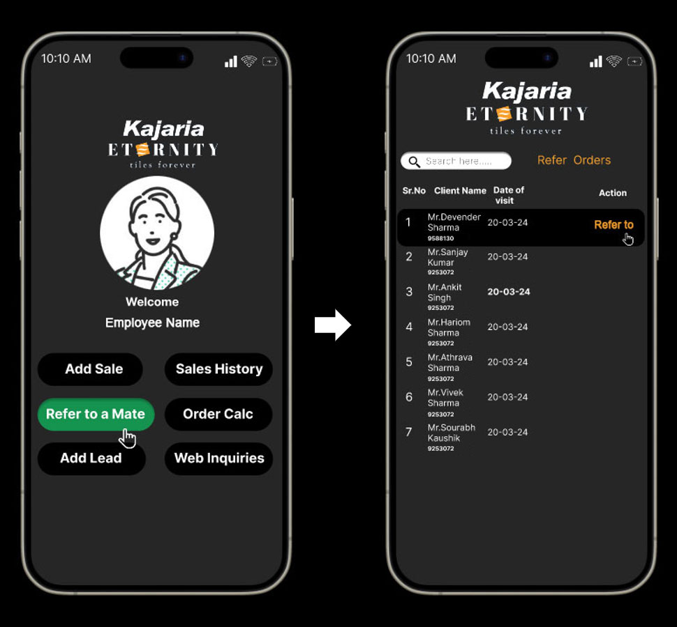
REFER TO COLLEAGUE
If Ms. Fatima is absent and a customer wants to visit the showroom, She can refer the customer to another present employee by clicking on "refer" and selecting the employee's name.
However, it doesn’t mean that the present employee can’t attend to the customer if not referred by the absent employee.
Ms. Fatima

Slide 15
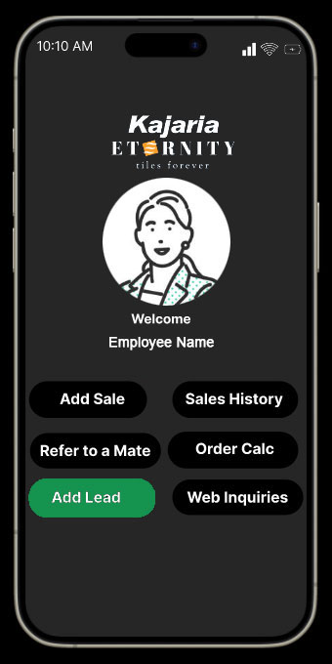
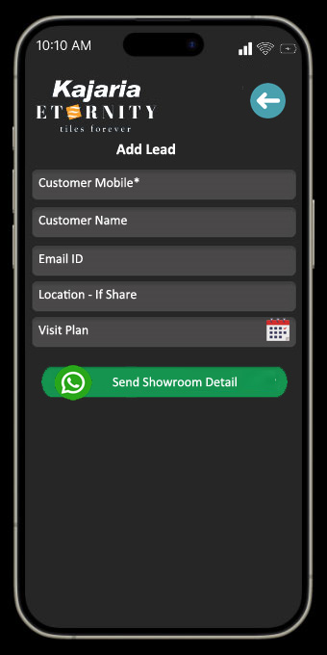
INSTANT WHATSAPP SHOWROOM DETAILS
If a customer calls the showroom for inquiries, Ms. Fatima can instantly send showroom details such as location, 360° view, address, and contact number to the customer's WhatsApp.
If plan for visit, an automated WhatsApp notification will be sent to the customer on that date as reminder.
Ms. Fatima

Slide 16
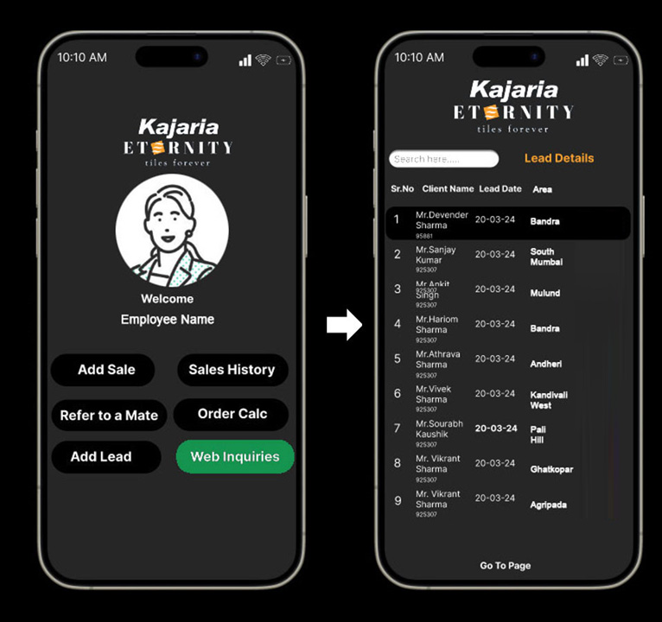
INSTANT CONTACT: WEBSITE INQUIRIES
Ms. Fatima can view website inquiries by location and instantly contact customers via call or WhatsApp with showroom details.
Call and WhatsApp icons are removed if another employee has already contacted the customer.
Ms. Fatima

Slide 17
FLOW OF MOBILE APP
SALES EMPLOYEE’S PERSPECTIVE

Slide 18
Let’s assume
Mr. Chirag is a Sales employee (retail and projects) in Mumbai.
He will log into the app with his registered mobile number and verify it with an OTP.
Hi Chirag

Slide 19
What we offer to Mr. Chirag
He can have all the options we offer to a Showroom Executive. Additionally, he will have the following options:
Lead Assignment to Dealers: He can assign leads to his dealers on WhatsApp for customers attended to by showroom executives. Since we do not provide an app to dealers, he must regularly update the status of each lead in the app.
Project-wise Reports: He can view project-wise reports if they belong to him.
Order Calculator: He can create a PDF of an order to share with the SAP person. It is just a simple calculator, and we are not saving any information here for tracking.
Complaints: He can view the complaints of his area. However, it is only for viewing purposes, and he can't take any action on them.
Chirag

Slide 20
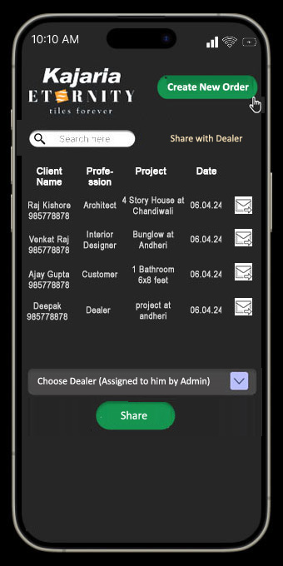
LEAD ASSIGNMENT
Sales Person can view all orders list and can assign to any dealers.
Once click on the SHARE icon, it will show DROP DOWN with list of DEALERS ASSIGNED to him and then he can assign particular Order to selected dealer.

Slide 21
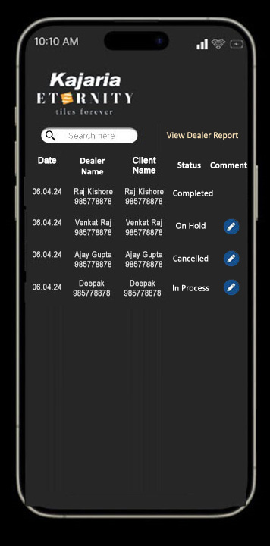
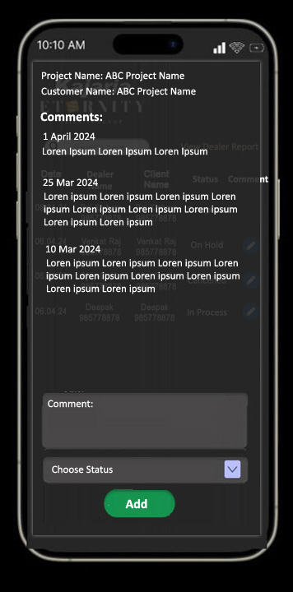
PROJECT WISE REPORT
Here Sales person can see all orders and Dealers to whole orders were assigned.
By clicking on EDIT icon, he add comments/updates against orders. And can also track all previous comments.

Slide 22
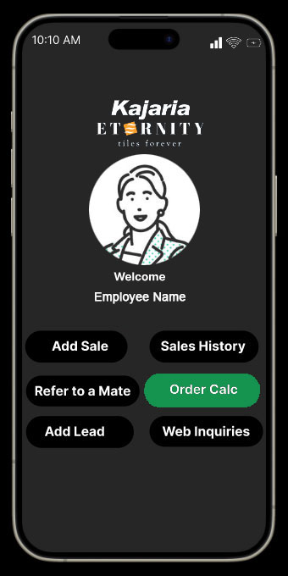
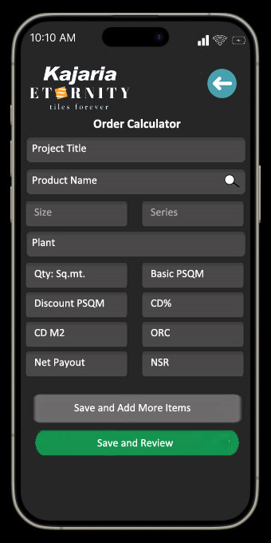
QUOTATION CALCULATOR
Since the quotation-making process is taking too much time, we are providing an option within the app for employees to create quotations and generate PDFs to share on WhatsApp.
MRP and taxes will be automatically displayed as per SAP.
Satish Sharma

Slide 23
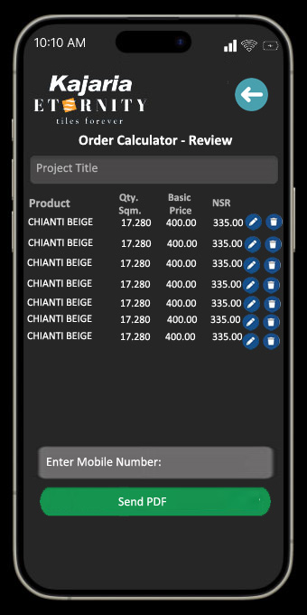
QUOTATION CALCULATOR
It's just a simple calculator; we are not saving any information for future reference, as discussed.

Slide 24
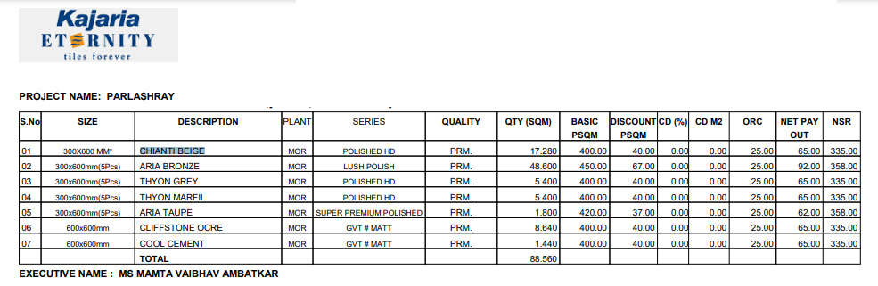
PDF Format

Slide 25
FLOW OF MOBILE APP
TEAM LEADER

Slide 26
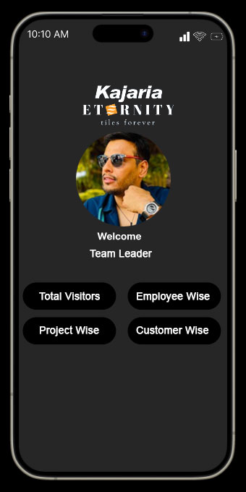
TEAM LEADERS REPORT
Total Visitors: Monthly and daily basis.
Employee-wise: Reports on the number of customers attended by each employee.
Project-wise: Instant status updates on all projects.
Customer-wise: Access to all visits of a customer by entering their mobile number in the app.
Complaints: He can view the complaints area wise.

Slide 27
FLOW OF MOBILE APP
COMPLAINT MANAGEMENT

Slide 28
OBJECTIVE
Our objective is to streamline the complaint process by minimizing manual intervention and ensuring a smooth experience for our customers & employees.
There will be two types of Login:-
Complaint Manager: Mr. Tarun Gupta
Engineers: Employees who visit customers' places to attend to complaints.

Slide 29
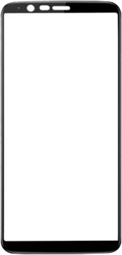
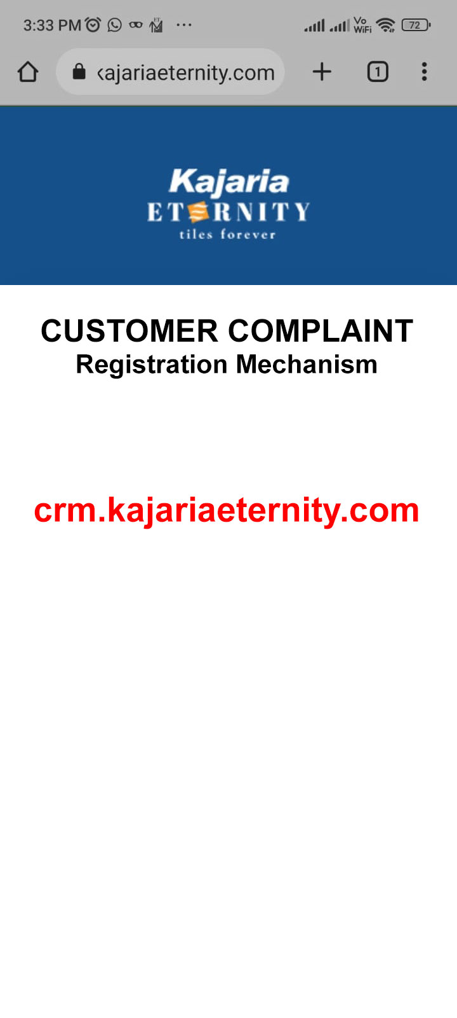





COMPLAINT REGISTRATION
Website
WhatsApp
Complaint registration will be done by five sources:-
Call Center
Chat Bots
Our Executives

Slide 30
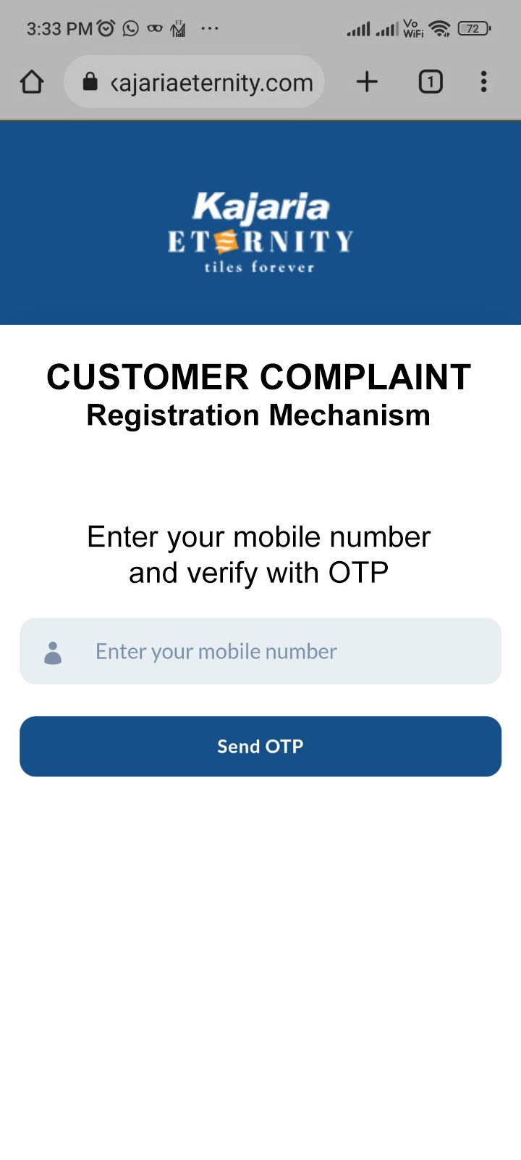
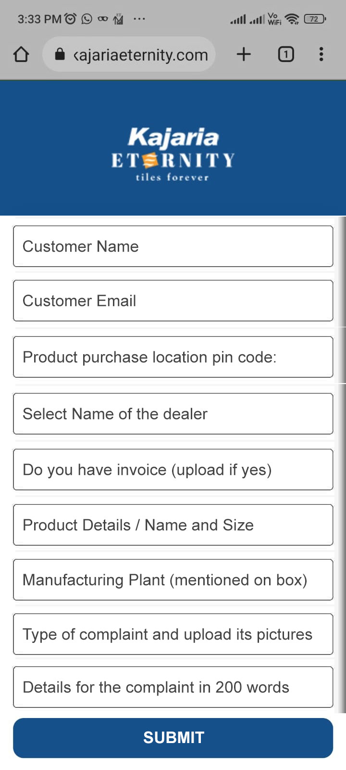
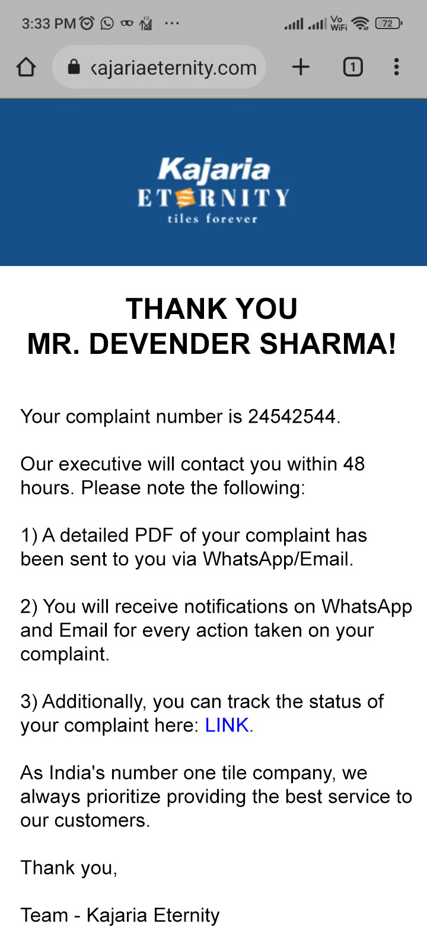
3 EASY STEPS TO REGISTER A COMPLAINT
STEP 1
STEP 2
STEP 3

Slide 31
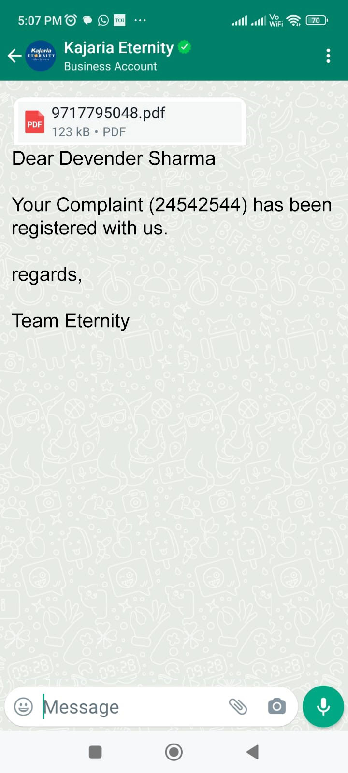
Customer Notifications
We will provide a detailed PDF to the customer once they register a complaint.
WHATSAPP

Slide 32
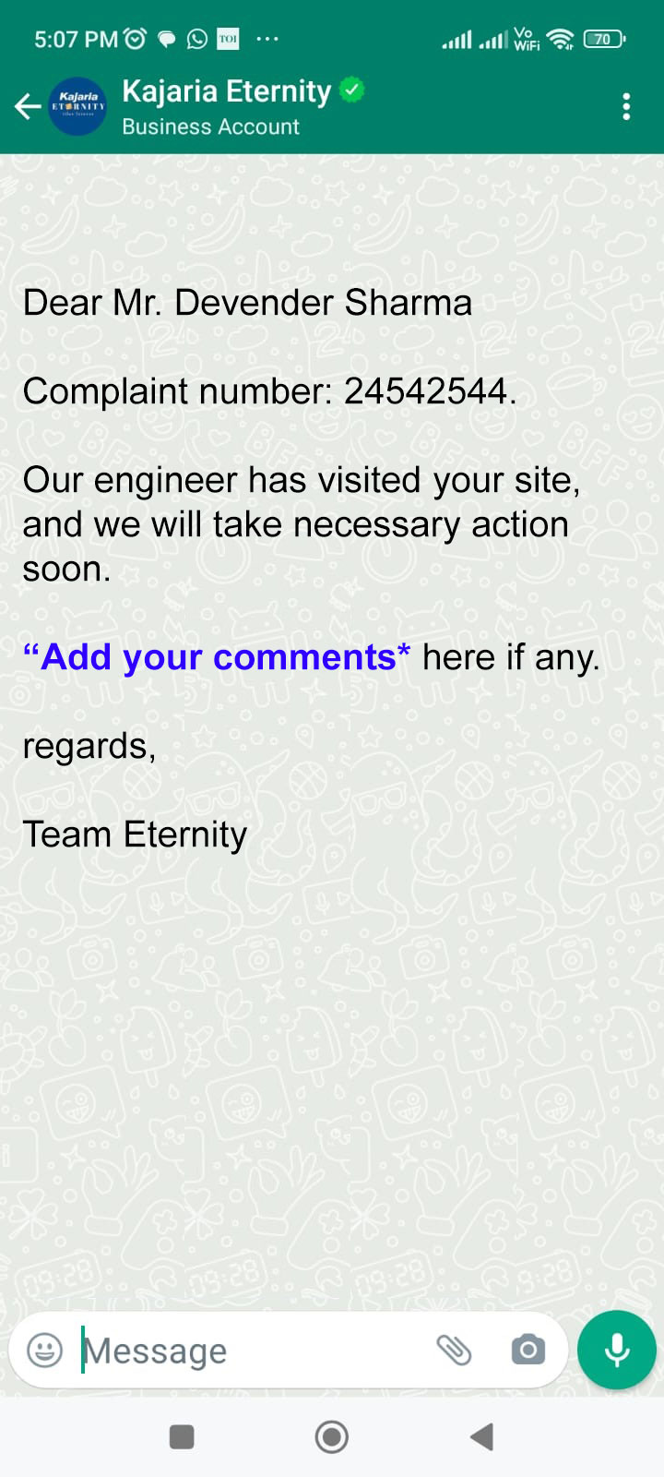
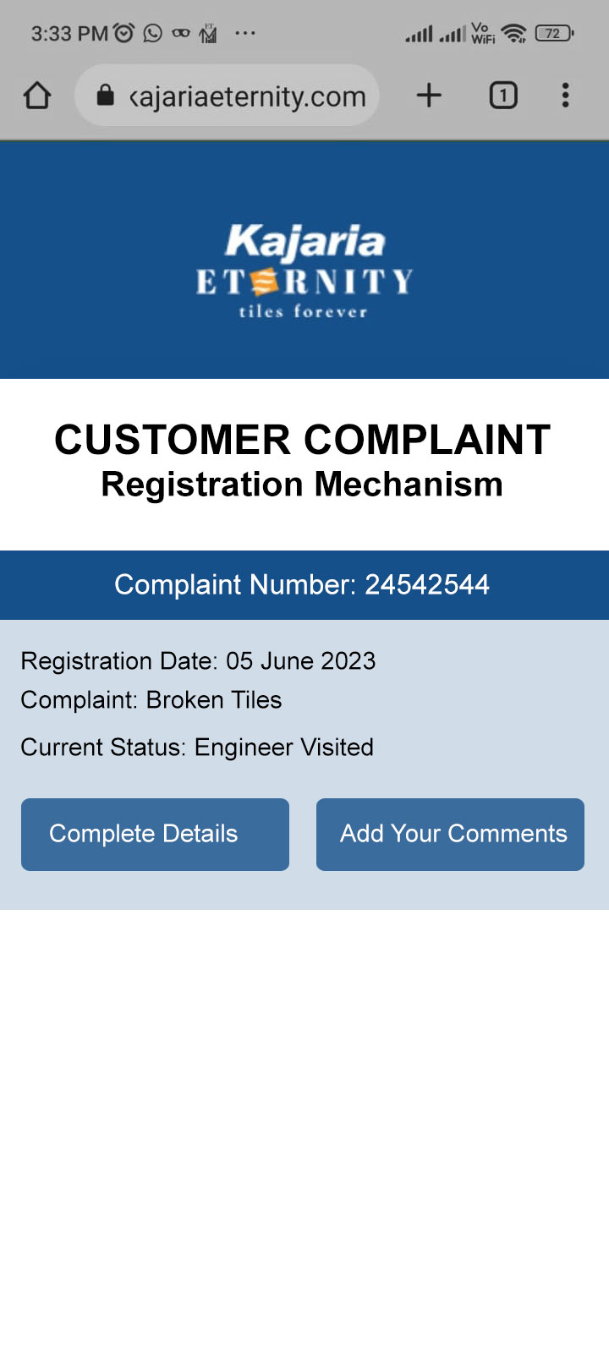
Customer Notifications
The customer will receive WhatsApp notifications regarding actions taken on their complaint.
WHATSAPP
Dynamic link

Slide 33
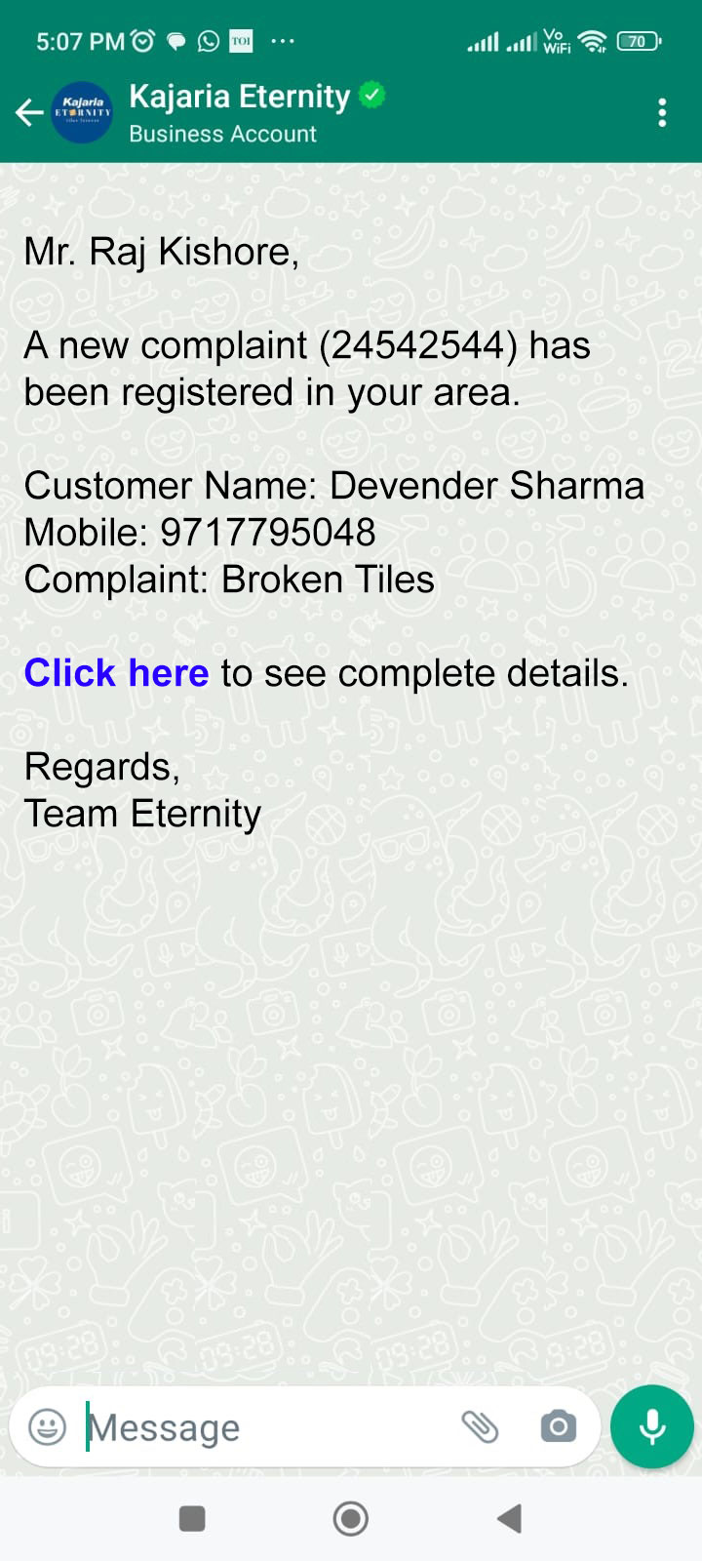
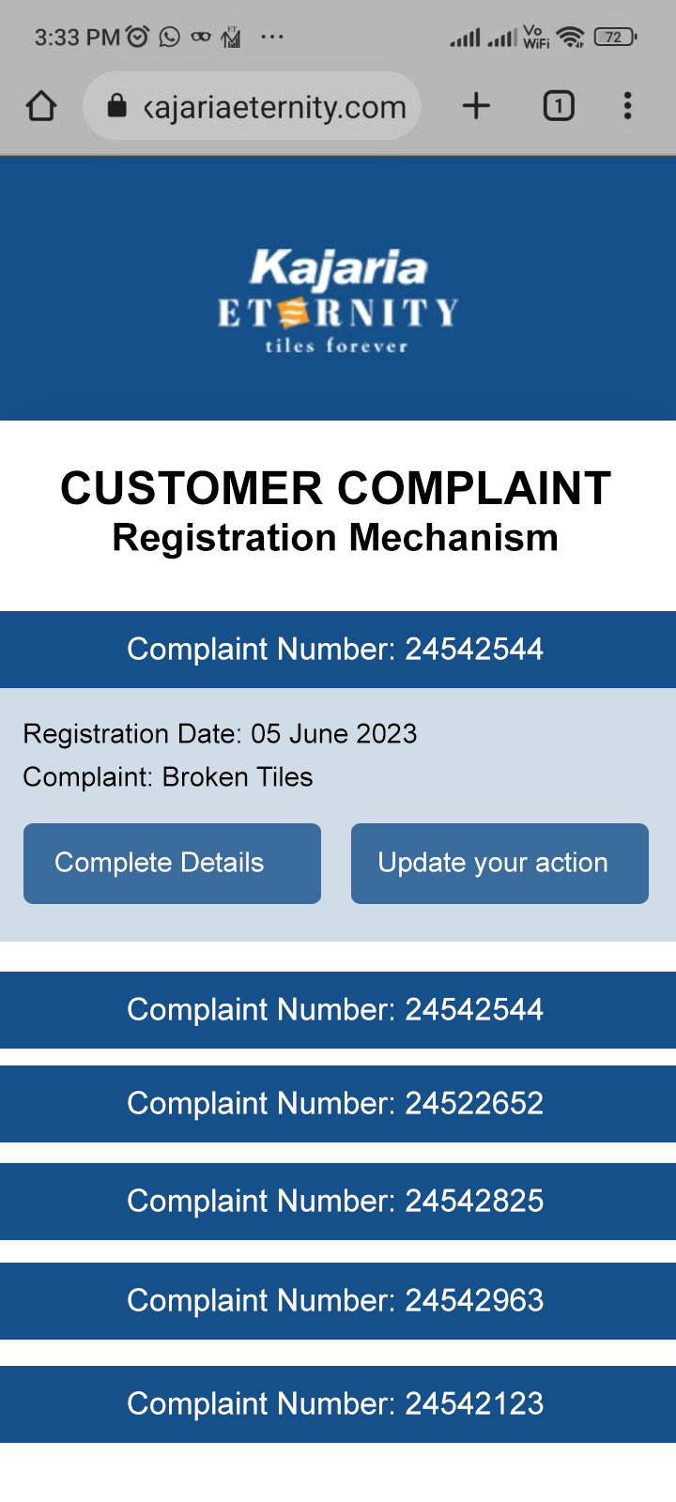
Engineer Notifications
WHATSAPP
ETERNITY APP

Slide 34
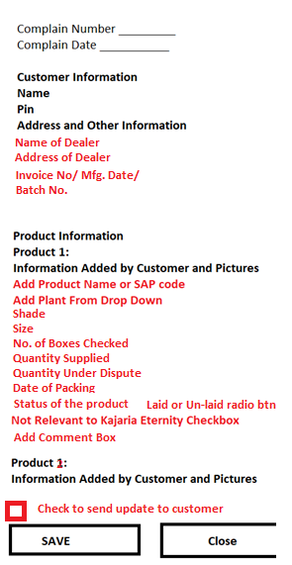
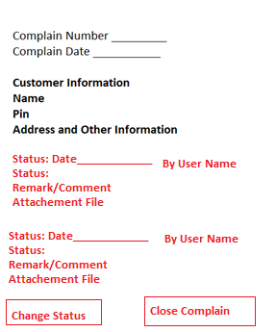
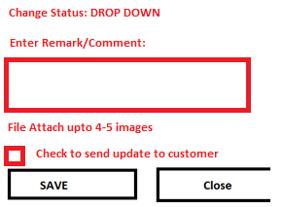
If user Click CHANGE STATUS button
If user click on CLOSE COMPLAIN button, check next screen

Slide 35
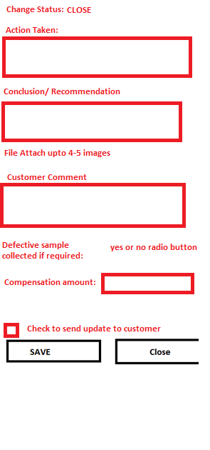

Slide 36
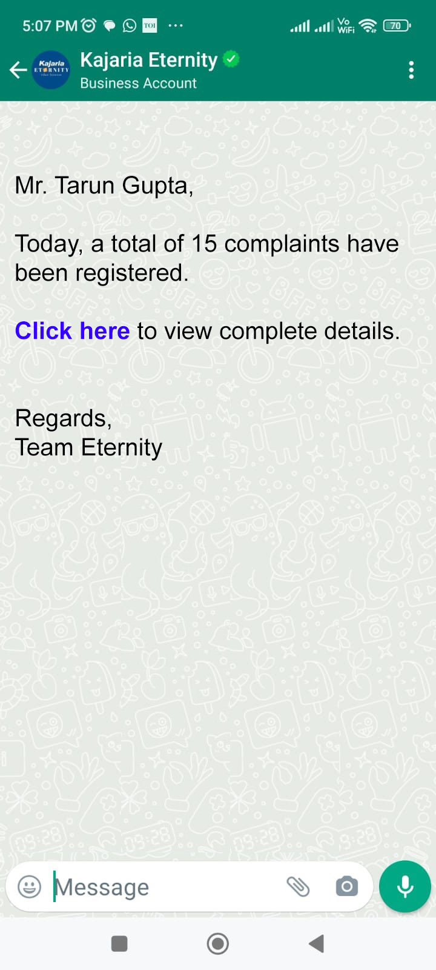
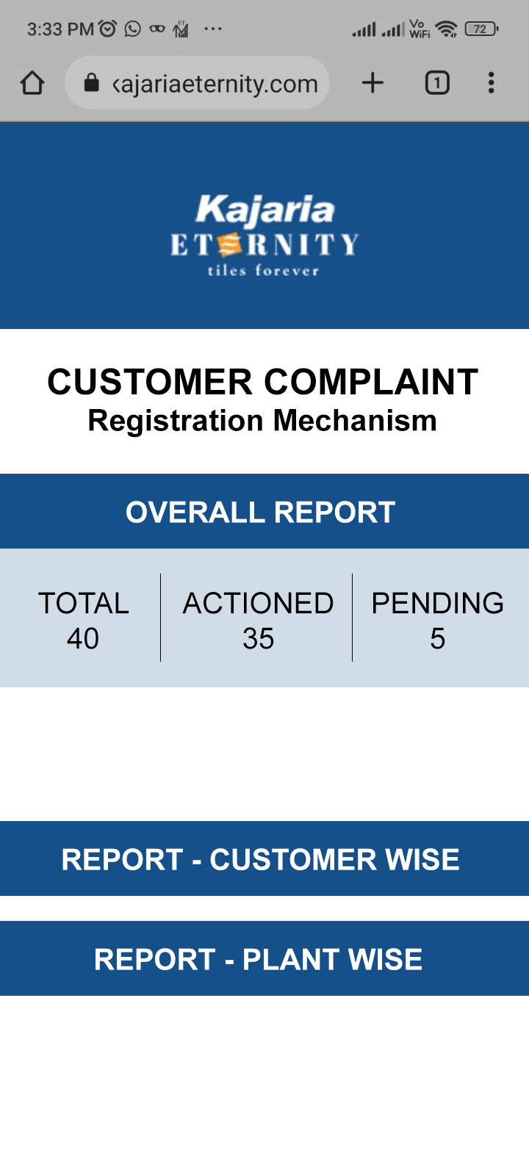
Admin Notifications & Reports
The system will send daily WhatsApp notifications to the admin, who can view the detailed report on their mobile via a provided link.
WHATSAPP
ETERNITY APP

Slide 37
Admin Notifications & Reports
CUSTOMER WISE REPORT
Start Date, End Date, Complaint number., Dealer wise, Product, Engineer, Complaint Status, Type of Complain, State, City
ETERNITY APP

Slide 38
Admin Notifications & Reports
PLANT WISE REPORT
Complaint type, Customer Message, Complaint number, Product UID, Complain Status
ETERNITY APP

Slide 39
Thank You!

